Slide 1
Music Data Analysis
Alec Arroyo

Slide 2
Business Case
As a company in the music industry, I want to find valuable information based on the lyrics of some of the most popular artists for different genres of music
Findings will include most frequently used words, trending lyrics, popular genres of music, and music genre prediction
These results can be applied when choosing and signing future artists
Will use machine learning models to predict genre of music based on song lyrics

Slide 3
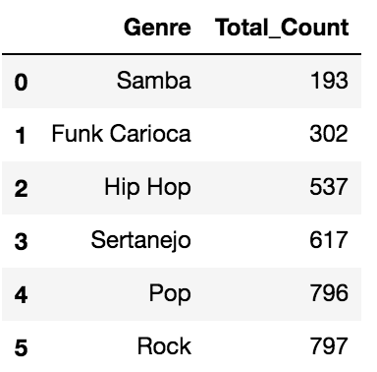
Data Source
Data was gathered from Kaggle: https://www.kaggle.com/neisse/scrapped-lyrics-from-6-genre
Artists Data CSV – 3,200 rows of data
Lyrics Data CSV – 209,522 rows of data
6 different genres of music
Several different fields
Artist
Song
Lyrics
Popularity
Genre
Num of Artists Per Genre

Slide 4
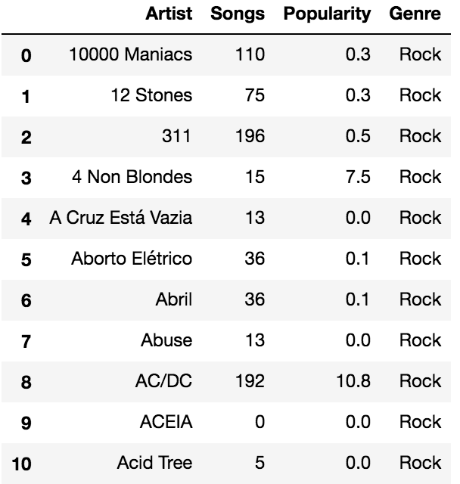
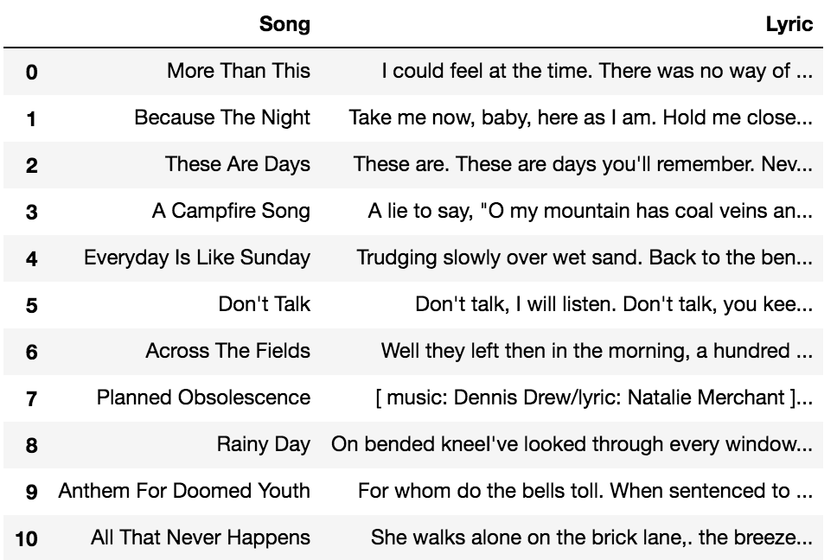
View of the Data
Artists Dataset
Songs/Lyrics Dataset

Slide 5
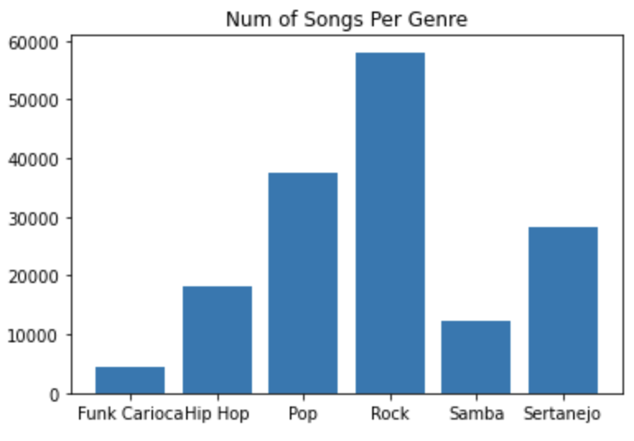
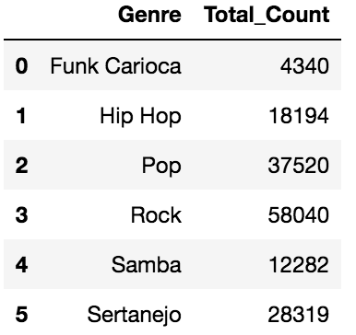
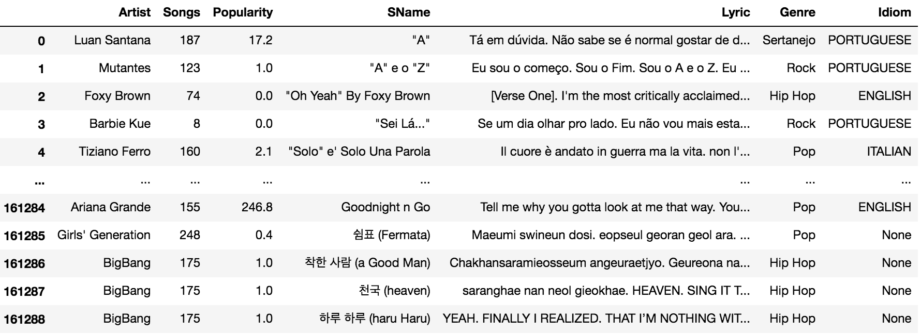
Visualizing the Data
Combined Two Datasets

Slide 6
Challenges with the Dataset
Lots of special characters
Mixture of lowercase/uppercase words
Song lyrics were in different languages such as Spanish, English, Portuguese
Not properly balanced
To many songs for Rock
Too little songs for Funk Carioca
All these needed to be accounted for when preprocessing data

Slide 7
Data Preprocessing Steps
Focusing on Lyrics field
Making all words lowercase
Adding Stemming – PorterStemmer()
Remove Stop words – NLTK
Words removed from English, Spanish, Portuguese, German
Removing Punctuation
Removing Whitespace
Removing Nulls/Blanks

Slide 8
Classification Models
Naïve Bayes Classification – will be running model to train and test data to predict the genre of music based on lyrics
Support Vector Machine - will be running model to train and test data to predict the genre of music based on lyrics
Splitting/Training techniques
Holdout method
Cross Validation with number of folds = 3

Slide 9
Splitting the Dataset
X = testdata['Lyric'].values
Y = testdata['Genre'].values
Library: sklearn.model_selection
Function: train_test_split()
Data was split at 60% training, 40% testing
Training Count = 95,217
Testing Count = 63,478
Num Training Ex Per Genre

Slide 10
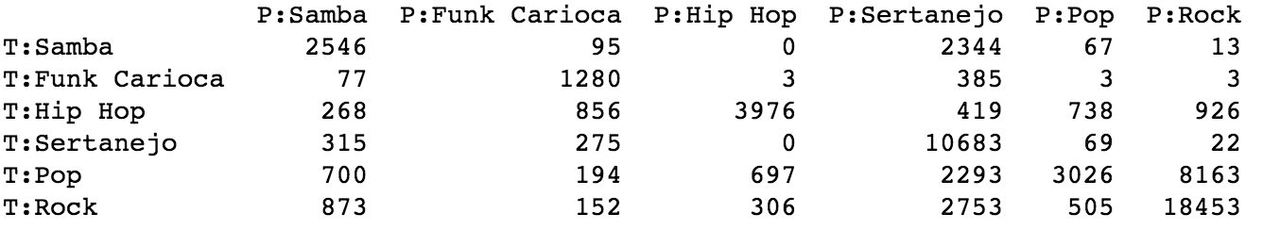
Naïve Bayes Model
MultinomialNB function - sklearn.naive_bayes package
Unigram Boolean Count Vectorizer w/ min doc frequency equal to 5
Initial accuracy of 62.99% using holdout method
Model predicted Rock, Sertanejo, Hip Hop the best
Model predicted Funk Carioca the worst
Confusion Matrix

Slide 11
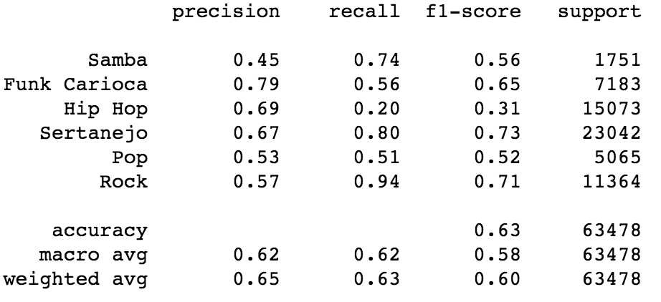
Naïve Bayes Cont.
Cross Validation accuracy: 71.05%
Number of folds = 3
Funk Carioca had the best precision score at 79%
Rock had the best recall score at 94%
Sertanejo had the best FI-Score at 73%

Slide 12
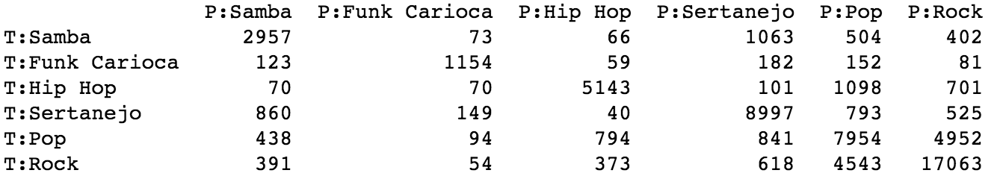
Support Vector Machines
LinearSVC - sklearn.svm package
Initial accuracy of 68.15% using holdout method
Model predicted Rock, Sertanejo, Pop the most
Model predicted Funk Carioca the least
Confusion Matrix:

Slide 13
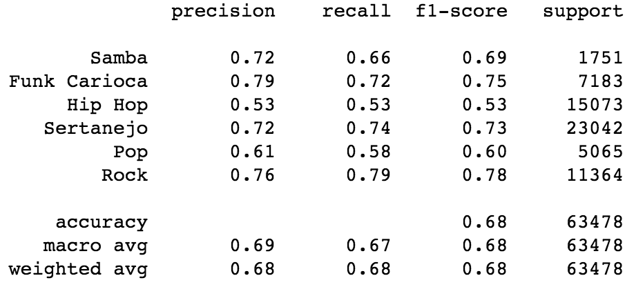
SVM Cont.
Cross Validation accuracy: 68.16%
Number of folds = 3
Funk Carioca had the best precision score at 79%
Rock had the best recall score at 79%
Rock has the best F1-Score at 78%

Slide 14
Key Findings
Trained and tested Naïve Bayes model to 71.05% accuracy to predict genre of music based on lyrics
Trained and tested SVM model to 68.16% accuracy to predict genre of music based on lyrics
These models can be used to declare the genre of music for new/young artists that are undeclared based on their song lyrics
Working on getting most frequent phrases/words
Working on removing bias by eliminating large portion of Pop and Rock data and adding Funk Carioca data

Slide 15
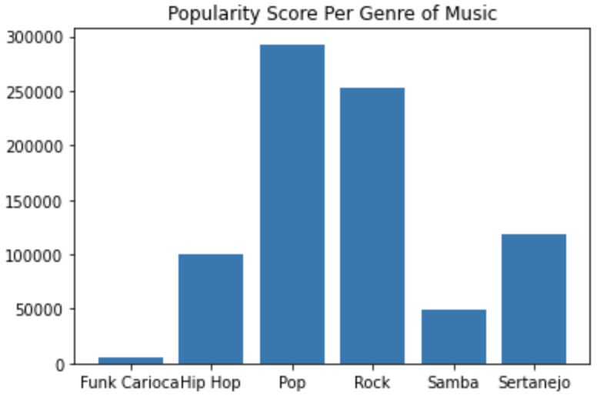
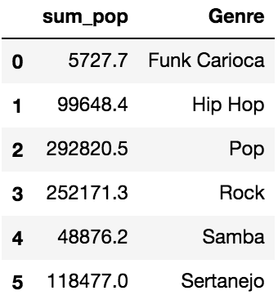
Key Findings Cont.
Most Popular Genres of Music:
Metric can be used to inform the company to hire mostly Pop or Rock artists for best profit

Slide 16
References
Kaggle Dataset: https://www.kaggle.com/neisse/scrapped-lyrics-from-6-genres?select=lyrics-data.csv

